Slide 1

Notes:
The City of Hope, a world-class medical & research institution and the Lions, have been partnered for over six decades. During this time the Lions have had a notable impact on the City of Hope community through our projects including the Lions Japanese Garden and the Lions Family Center. We now have a new opportunity to expand our partnership.

Slide 2
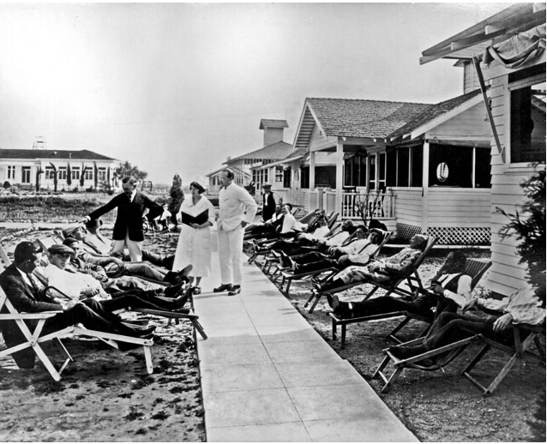

The City of Hope Story
The City of Hope story began in 1913, when a group of volunteers, spurred by compassion to help those afflicted with tuberculosis, established the Jewish Consumptive Relief Association (JCRA) and raised money to start a free, nonsectarian tuberculosis sanatorium on 10 acres of sun-soaked land in Duarte, where they would establish the Los Angeles Sanatorium.
By the mid-1940s, thanks to the discovery of antibiotics, tuberculosis was on the decline in the U.S. However, City of Hope rose to the next medical challenge, tackling the catastrophic disease of cancer — and later on, diabetes and HIV/AIDS — while reaffirming its humanitarian vision that “health is a human right.”

Slide 3
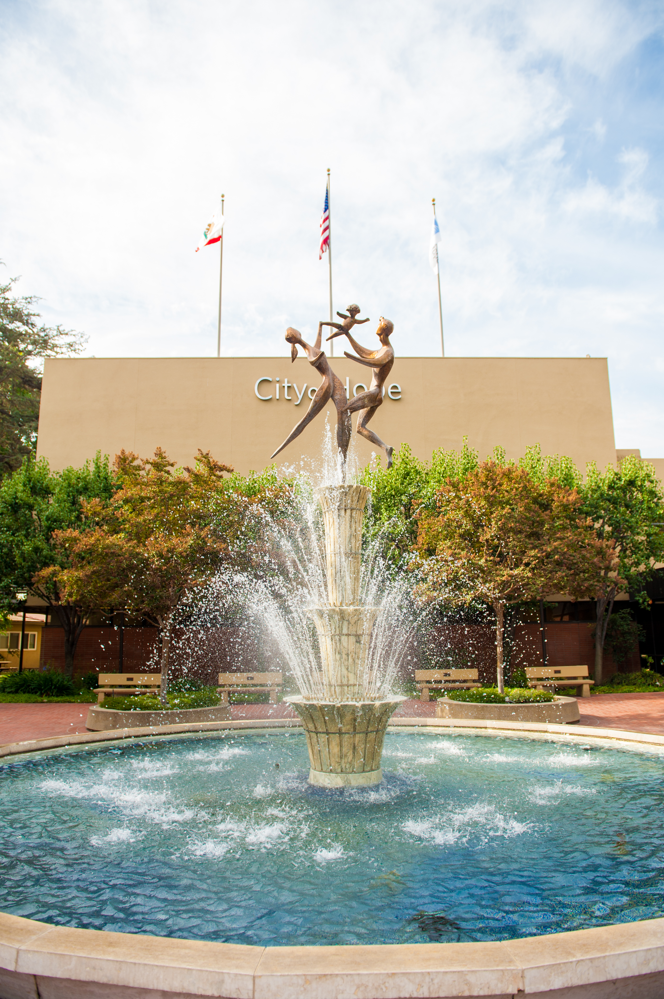
What is City of Hope?
City of Hope is dedicated to making a difference in the lives of people with cancer, diabetes and other serious illnesses. Their mission is to transform the future of health care by turning science into a practical benefit, hope into reality. City of Hope accomplishes this by providing outstanding care, conducting innovative research and offering vital education programs focused on eliminating these diseases.
City of Hope scientists work with doctors to treat both the physical and emotional needs of their patients. By attending to the individual, not just the illness, life afterwards can be fuller and more rewarding.
As Lions we are united by our desire to find cures, save lives and transform the future of health. Every discovery City of Hope makes and every new treatment they create gives people the chance to live longer, better and more fully.

Slide 4

City of Hope Values
COMPASSION
From day one, compassion has been woven into the heart and soul of City of Hope.
SERVICE WITH A SENSE OF URGENCY
Focusing on turning great science into practical benefit as quickly as possible.
INTEGRITY
Choosing the right path, not the easy one.
INTELLECTUAL CURIOSITY
City of Hope’s reputation for scientific excellence stems from their determination to aggressively pursue new lines of inquiry.
EXCELLENCE
Commitment to advancing science while providing compassionate care has established City of Hope as the benchmark in fighting cancer, diabetes and other life-threatening diseases.
COLLABORATION
Working as one team, united by a common purpose – not just within the organization but with other institutions around the country.

Slide 5

City of Hope in 2019
Best in the West
According to U.S. News & World Report’s 2019-20 Best Hospitals: Specialty Rankings issue. This marks the 13th consecutive year that it has been distinguished as one of the nation’s elite cancer hospitals.
1 of 50 Comprehensive Cancer Centers
The highest designation possible from the National Cancer
Institute and a metric used by U.S. News & World Report.
To earn this designation, a center must undergo a rigorous peer-review process, maintain a high number of cancer research projects and be heavily involved in community outreach, as well as meet other academic and public service requirements. City of Hope earned its comprehensive cancer center designation in 1998 and has maintained it since.
#4 in Patient Experience
This year, U.S. News & World Report added data from Hospital Consumer Assessment of Healthcare Providers and Systems, which tracks exemplary patient experience. City of Hope was ranked fourth in the country out of 885 hospitals surveyed.

Slide 6
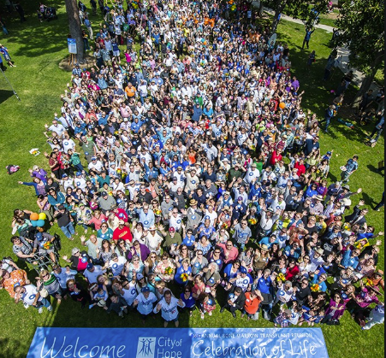
City of Hope and Cancer
City of Hope continues to be at the forefront of a powerful form of immunotherapy known as CAR T cell therapy.
Immune cells are taken from a patient’s own bloodstream, reprogrammed to recognize and attack a specific protein found in cancer cells, then reintroduced into the patient’s system, where they destroy the targeted tumor cells.
City of Hope is a pioneering leader in the field of blood cancer.
Since 1976 City of Hope’s bone marrow and stem cell transplant program has grown into one of the largest, most successful programs of its kind in the United States, with more than 15,000 procedures performed to date.
42nd Annual Bone Marrow Transplant Reunion

Slide 7
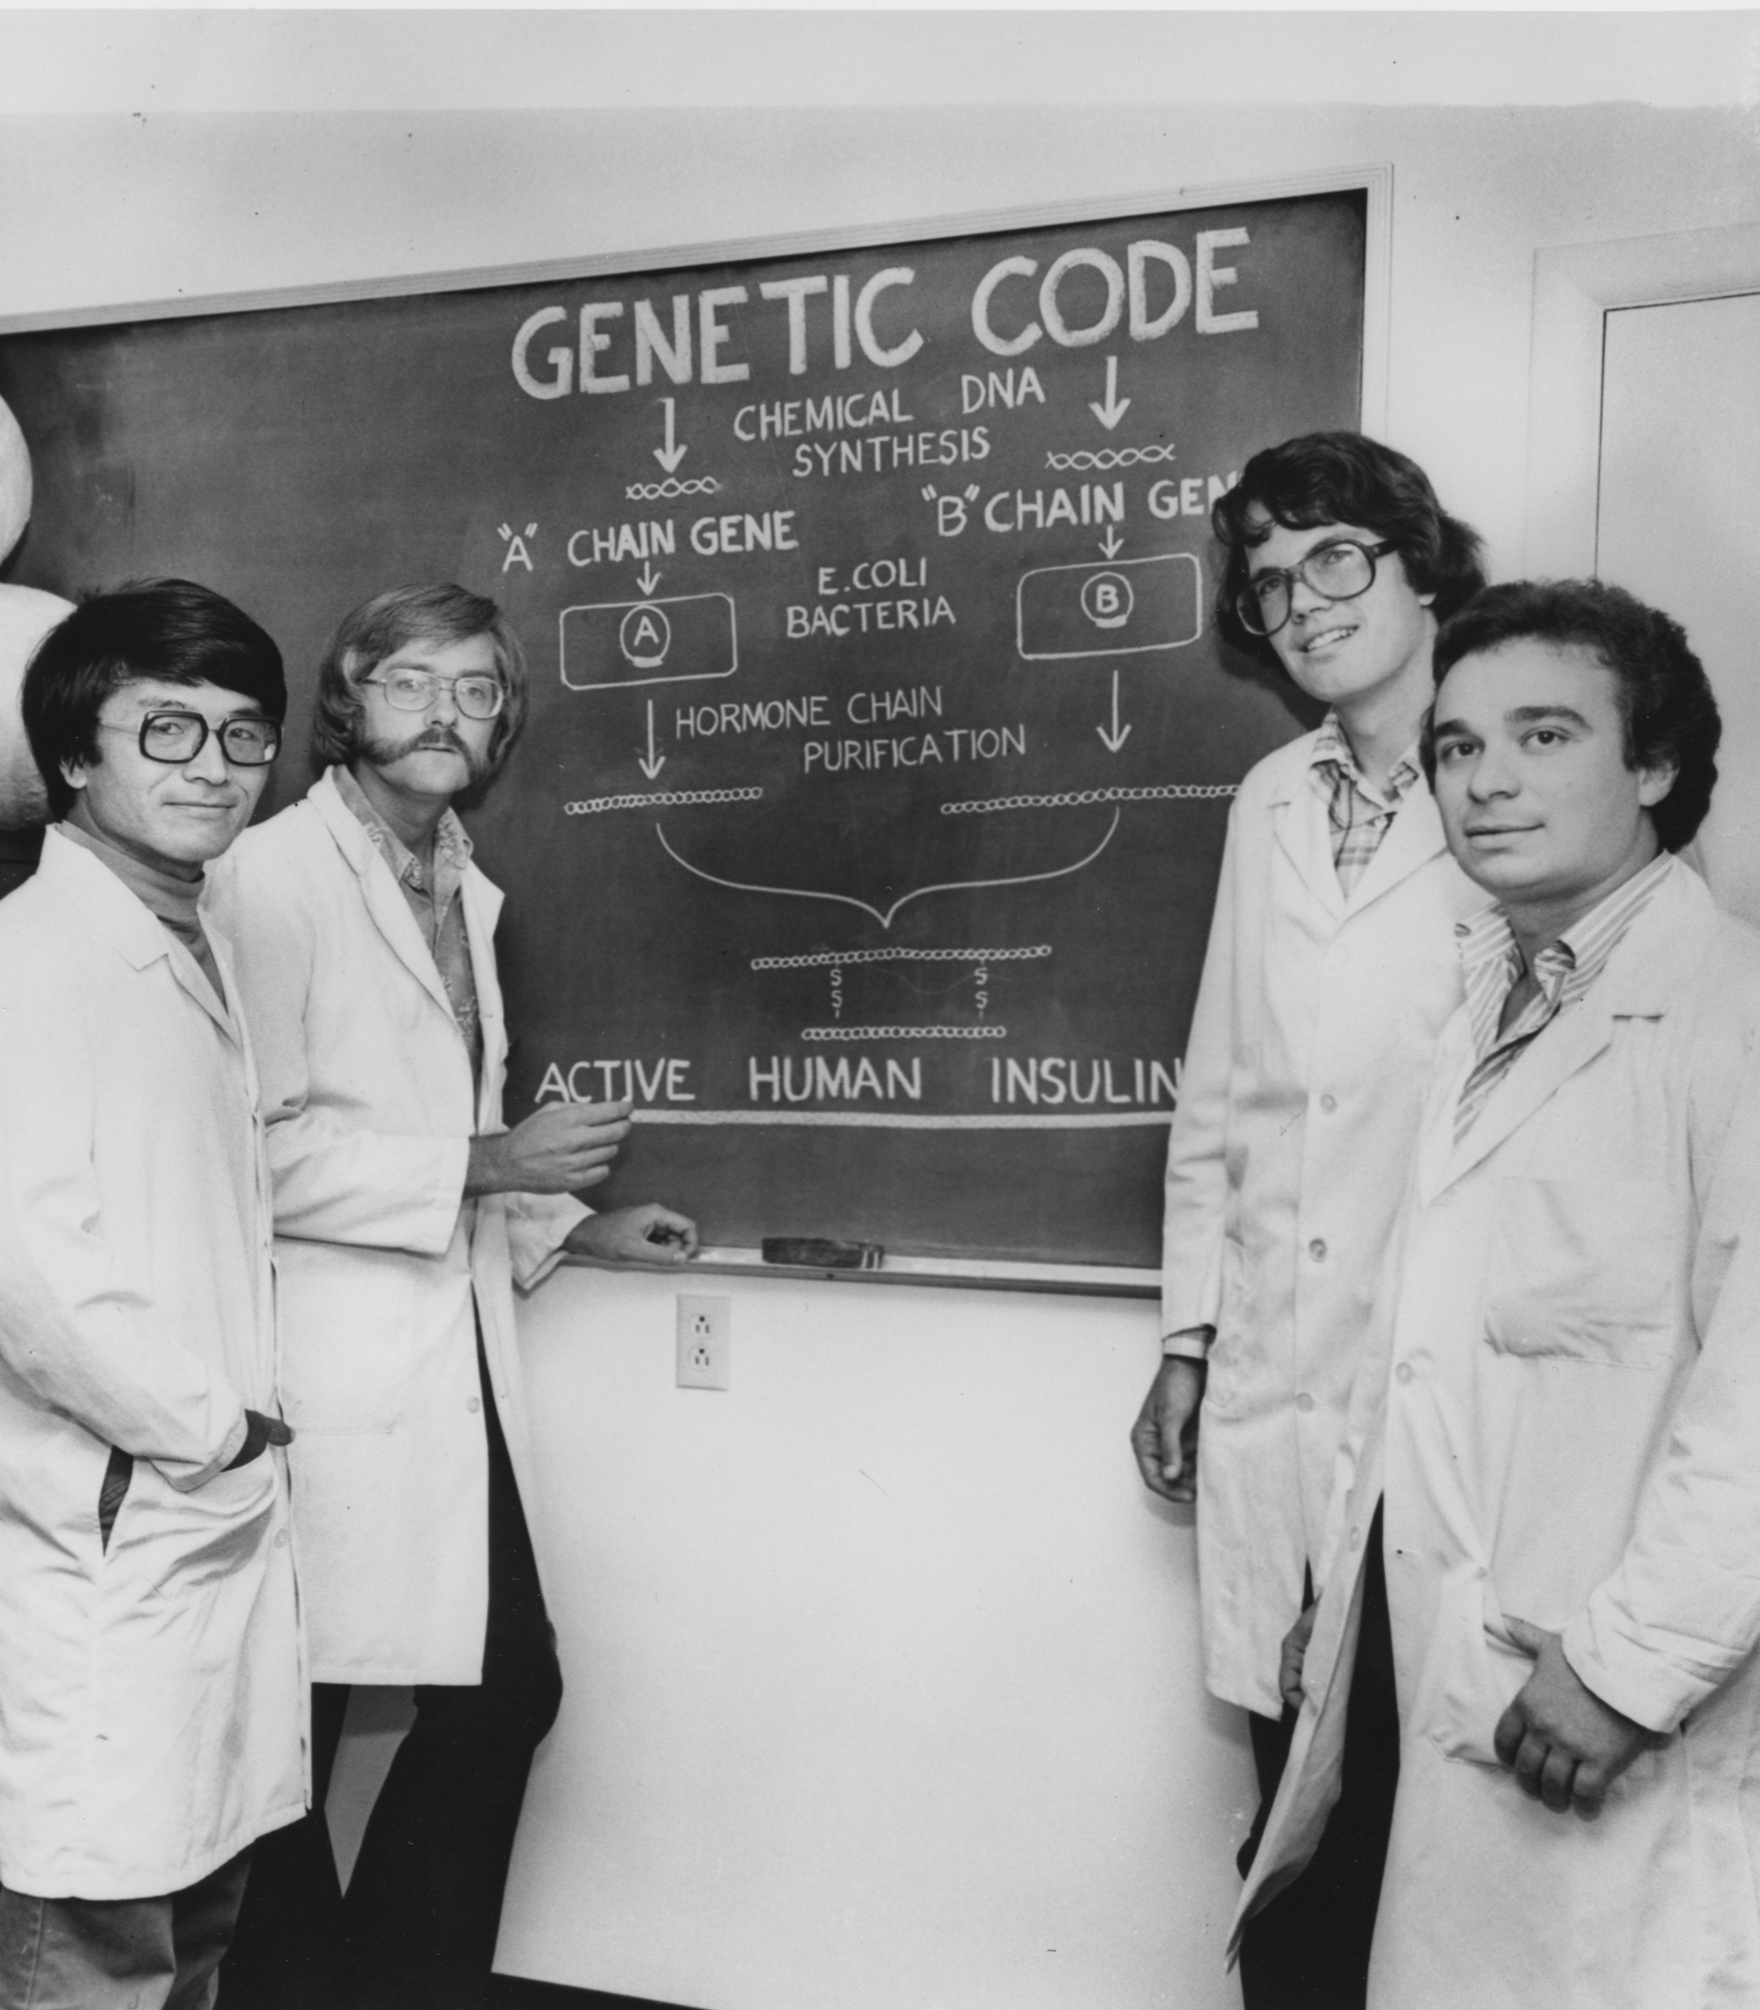
City of Hope and Diabetes
Although world renowned for its work in research and treatment of cancer, City of Hope has a long and impressive history of groundbreaking discoveries in the field of diabetes. It spans seven decades of intense investigation since the discovery of the effect of insulin in the 1940s. Researchers at City of Hope were the first to identify the marker for blood glucose control, which remains the gold standard used by physicians around the world to manage patients with diabetes.
Synthetic human insulin, which is used worldwide by millions of people with diabetes, was first discovered and produced at City of Hope.

Slide 8
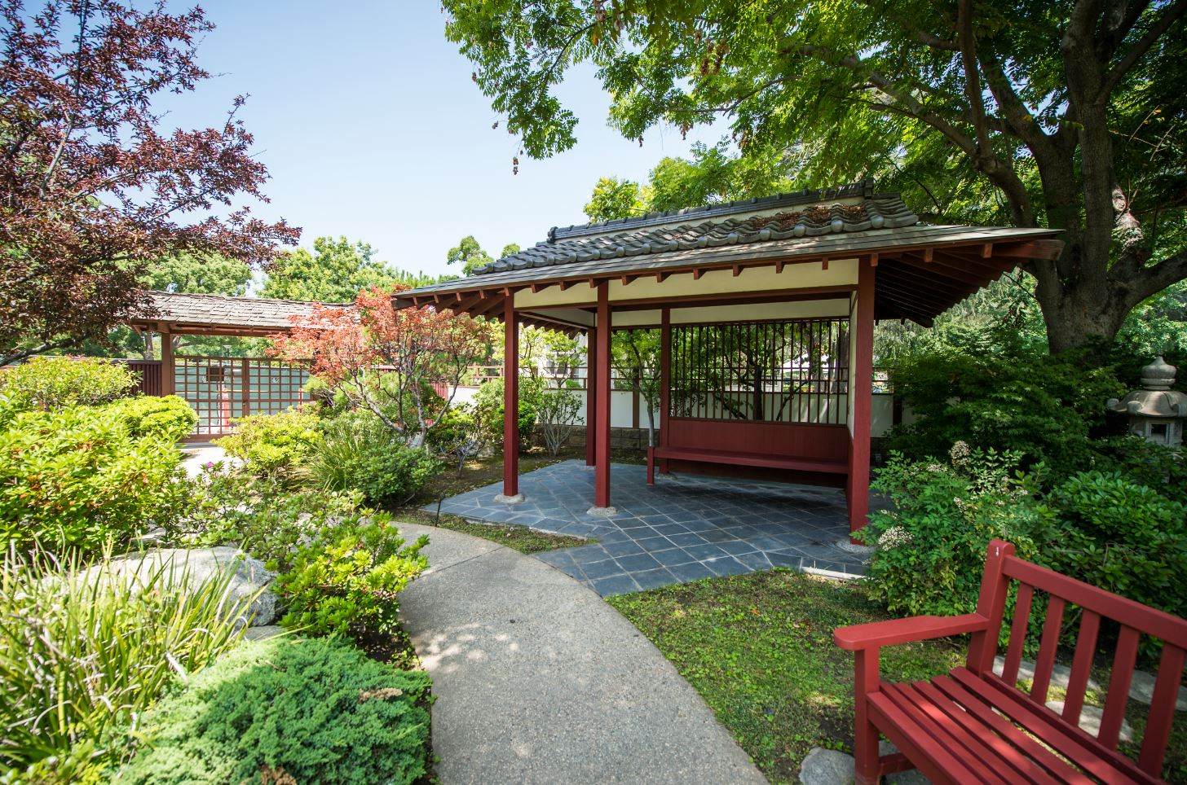
City of Hope and the Lions Clubs International
At virtually every turn on the City of Hope campus there is a ready evidence of Lions' generous support to City of Hope.
The Lions Clubs International Japanese Garden, located in the center of the City of Hope campus, has been a shining beacon of the Lions commitment to helping people in need. The Japanese Garden serves as a place of respite for the patients undergoing difficult treatments, which is very important in the healing process.
In 2018, with an official ribbon cutting ceremony, the Lions Clubs International Family Center at City of Hope was officially unveiled. The completion of the Lions Clubs Family Center fundraising program, provided a vast restoration of this crucial part of City of Hope's campus that enables patients to remain close to medical treatment and supportive care services while continuing their outpatient care.

Slide 9
Why Diabetes is an Epidemic
An estimated 30 million Americans have diabetes, and nearly 1 in 4 of those are unaware of the condition.
Diabetes is a leading cause of adult blindness in Americans. Diabetics are 40% more likely to have glaucoma and 60% more likely to have cataracts. Left unchecked, vision loss due to diabetes is irreversible.
Diabetes is the seventh leading cause of death in the U.S., and it contributes to mortality from heart disease, stroke and kidney failure. Type 2 diabetes is also associated with an increased risk for several cancers, including pancreas, liver, breast, colorectal and genitourinary.
Since 1980, worldwide rates of type 2 diabetes have quadrupled.
The number of obese children and adolescents has soared tenfold, setting the stage for an epidemic of type 2 diabetes.
Notes:
Lions Clubs International decided to prioritize Diabetes because the facts show this is rapidly becoming a pandemic. The Lions identified the need to combat diabetes more aggressively because of its global implications. In response MD-4 formed a committee to explore how to best tackle this task. I want to introduce the member’s of the MD-4 Diabetes Committee. Together with the City of Hope, we worked to find a combined approach to accomplish our goal. We are very excited to announce the Lions Clubs Diabetes Innovation Fund.

Slide 10
The Lions Clubs Diabetes Innovation Fund at City of Hope
City of Hope and The Lions Clubs International to partner on finding new ways to prevent and treat type 2 diabetes and its complications.
The Lions Clubs Diabetes Innovation Fund will consist of projects that are diverse in aims, with studies identified and prioritized by their potential to advance research on type 2 diabetes and its many complications.
The Fund would support the most promising new ideas through a competitive selection process that would award two or more seed grants up to $100,000 per year, with the potential for renewal. The selection process and oversight would be conducted by a team of expert City of Hope researchers.
With a total investment of $1,000,000 over five years, Lions Clubs will have the opportunity to establish the Lions Clubs Diabetes Innovation Fund and drive research leading to prevent and treat type 2 diabetes.
We have set a global goal to confront diabetes. Combining research advances with our community and patient support efforts will make an enduring impact on the future of the disease, and on humanity.
Notes:
Here is an outline of the thrilling new project we will be launching that will address the research needs of type 2 diabetes.

Slide 11
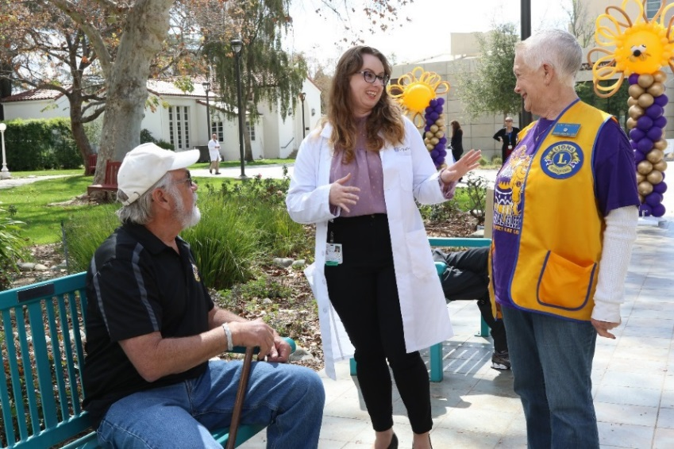
City of Hope and Lions Clubs Partnership
The investment will allow Lions Clubs to interact with the research team, understand the research process, and hear about groundbreaking discoveries directly from members of City of Hope’s renowned research team.
Annual reporting will include progress reports from the research projects that were funded by the innovation fund and invitations to the City of Hope campus to meet and interact with the research staff who receive Lions funding.

Slide 12

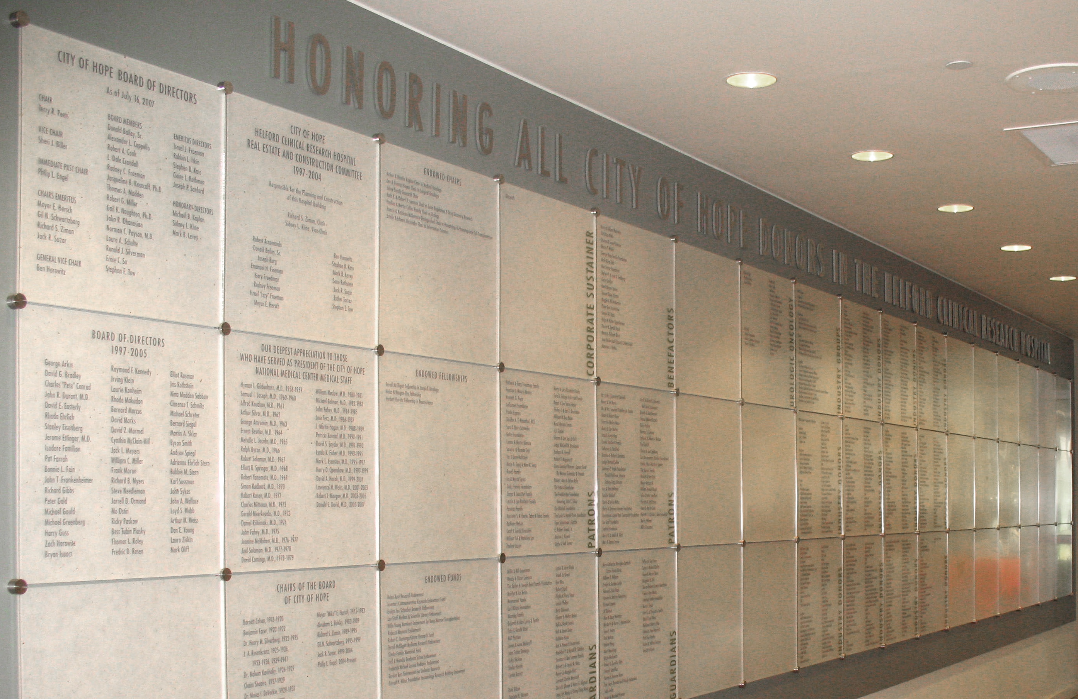
Lions Clubs Diabetes Innovation Fund Recognition
A recognition panel will be located on the lower level of the Geri & Richard Brawerman Center for Ambulatory Care, in the highly trafficked lobby for the Diabetes, Endocrinology & Metabolism Department. This prominent location will honor the Lions’ commitment to diabetes research.
Recognition will also be added to Main Donor Wall in the Grand Lobby in the City of Hope Helford Clinical Research Hospital. This highly visible and distinguished location, will recognize the Lions’ steadfast commitment to advancing care for people everywhere.
Diabetes, Endocrinology & Metabolism Clinic
Main Donor Wall Recognition
Notes:
The recognition for this project will include a panel on the lower level of the Geri & Richard Brawerman Center for Ambulatory Care. Highly trafficked lobby for the Diabetes, Endocrinology & Metabolism Department. Additional recognition will also include the Main Donor Wall in the Grand Lobby in the City of Hope Helford Clinical Research Hospital.

Slide 13
The Moment is Now!
People around the world who are fighting diabetes and facing debilitating complications are empowered by the promise of experimental new research that may reveal how type 2 diabetes develops. This can lead to treatments that will spare hundreds of millions of people from stroke, heart attacks, kidney disease and other illnesses that result.
Philanthropic partnership is more crucial now than ever before; the Lions’ generosity is revolutionizing research into type 2 diabetes.
With the support of the Lions Clubs International, City of Hope can continue to push the boundaries of science; to discover preventative measures and advance treatments that extend quality and length of life while cultivating hope for people with diabetes and their loved ones.
Notes:
When Lions Clubs International made the global commitment to lead the way in the fight against diabetes, MD-4 realized a unique opportunity right here in our own backyard. City of Hope, who has been our long-term partner is also a global leader in diabetes treatment, research, and prevention. City of Hope, after all, was the place where synthetic insulin was discovered and developed and continues to be at the forefront of the cutting-edge work in the field. We immediately recognized another opportunity to do great things together.

Slide 14

THANK YOU

